Slide 1
1.5.3 Walkthrough #2 color_string_changer.py color_changer.py
Computer Science and Software Engineering
© 2014 Project Lead The Way, Inc.

Slide 2
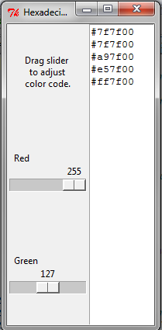
Demo: color_string_changer.py

Slide 3
CS Skill: Hexadecimal
Hexadecimal is base 16
Digits 0,1,2,3,4,5,6,7,8,9,A,B,C,D,E,F
Four bits each since 16 is 2⁴
Place value is 16^{n}
_A__ __5_
16’s 1’s
place place
So “A5” in hexadecimal is Ax16¹ + 5x16⁰
= 10x16 + 5x1
= 160 + 5 = 165
Easier to handle complexity if we don’t think of all details at once
Notes:
In decimal, there are 10 digits: 0 through 9. In hexadecimal, there are 16 distinct digits: 0 through F. A represents 10, B represents 11, and so on up to F for 15. The place values are powers of 16. One byte can contain values 0 to 255 and is represented by two hexadecimal digits.

Slide 4
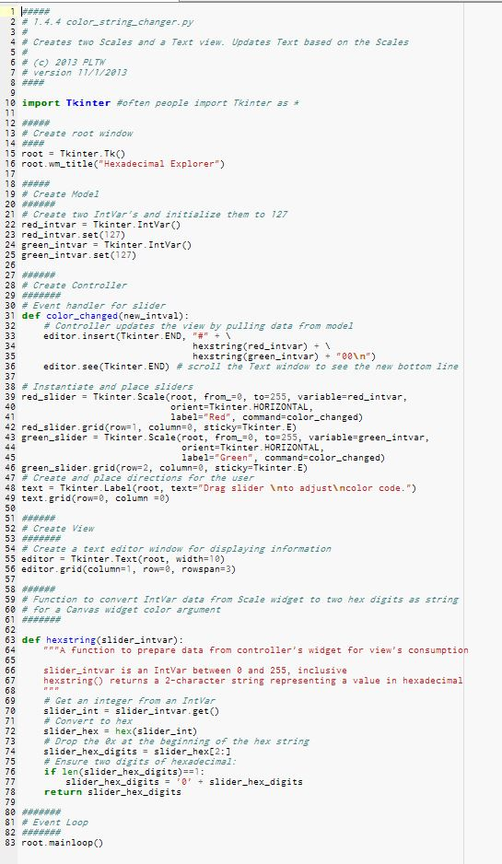
Header, Initialize
Notes:
This program demonstrates the wm_title() method of the Tk.

Slide 5
Model
Notes:
The program will need two IntVars, one for each scale widget.

Slide 6
Model – Part I: Event Handler
Notes:
To make the controller (the two sliders), we first need handler to give the constructor function. The two sliders can have the same handler function. If either slider is changed, we want the handler to print a new color string in the text window.
This function hexstring() is one we define later in the code. Apparently, it takes an IntVar as an argument and returns a string. We can tell that because its return value is being concatenated with other strings.
END is a constant defined in Tkinter. We refer to it from its namespace by using a “full qualified name” That’s because we didn’t import Tkinter with “from Tkinter import *”

Slide 7
CS Concept: Declaration
Notes:
How can we use hexstring() here if it isn’t defined until later in the code? Python doesn’t execute function definitions right away. It only executes the def line itself. The contents are interpreted the first time the function is called. In this way, the Python def statement is a bit like other language’s forward declaration. Declaration is when code declares it will use a token but doesn’t yet necessarily fully define it.

Slide 8
Model – Part II: Scales
Notes:
We create two scales and attach them to our event handler.

Slide 9
Model – Part III: Scales
Notes:
This Label tries to make it self explanatory how to use the GUI. A GUI shouldn’t need a person there to tell you how to use it!

Slide 10
View
Notes:
The Text is used by the handler above.

Slide 11
View
Notes:
The built in hex() function of Python will convert an int type to a string that represents hexadecimal. The string begins with 0x to indicate that it is hexadecimal. So if the slider is at 160, then slider_hex in line 72 will be “0xA0”.
Line 74 chops off the 0x using string slicing.
Line 77 tacks a 0 on the front if it was only a one-digit hexadecimal.

Slide 12
Event Loop
Notes:
Everything always has to be set up before the event loop.

Slide 13
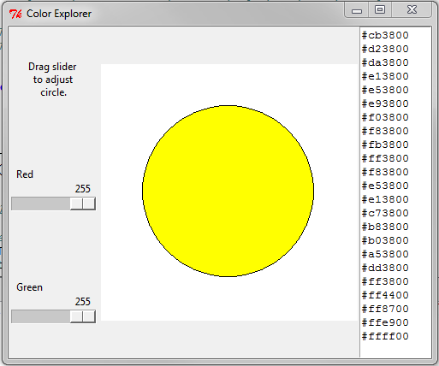
Demo: color_changer.py
Notes:
Your teacher will demonstrate the color_changer.py program, and then you will create it.

